Slide 1
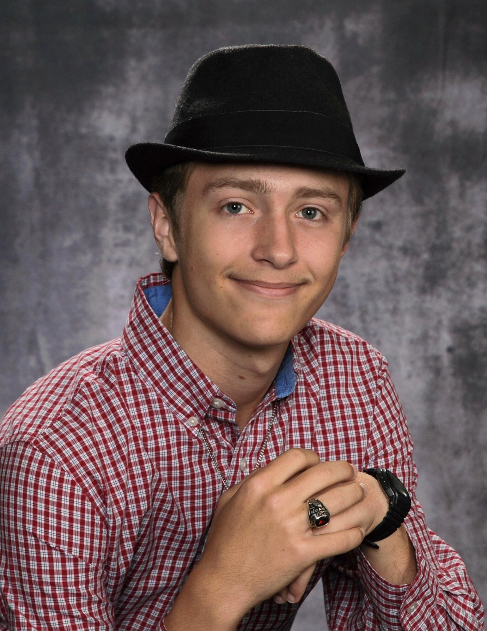
Self-Contained Dye Laser Cavity for UV Sunscreen Absorbance Testing
Group 4
Bell, Ryan; PSE
Ephraim, John; EE
Zamora, Berny; EE

Slide 2
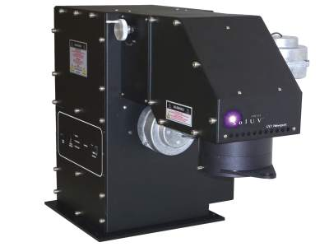
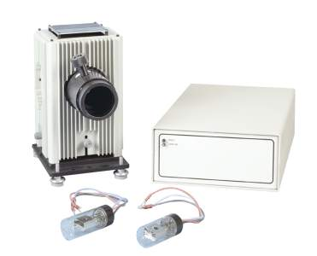
Introduction
Absorption Testing
Measure optical power before and after the object in question
Typically done with arc lamps or filament bulbs

Slide 3
Technology Comparisons
 | Sol-UV | Q-Series Deuterium | QTH | Our Design | Additional Comments
Source | Xenon Arc Lamp | Deuterium Arc Lamp | Quartz Tungsten Halogen filament bulb | Laser Dye | Allows for coherence and higher input-output power efficiency.
Coherence | Incoherent | Incoherent | Incoherent | Coherent | Unsure as to the significance of this difference. Is likely dependent on the specific application.
Approx. Max Irradiance (mW m⁻² nm⁻¹) | .6 @ 360 nm | 1.1 @ 200 nm | 300 @ 800 nm | Unknown | Due to using a laser based approach, max irradiance will be consistently at the max lasing wavelength of the used dye and could theoretically be much higher than the examples.
Lifetime | 1000 hours | 2000 – 2500 hours | 75 – 150 hours | >8 hours | We hope that this shorter operation time is made up for in higher specific irradiance and the ease of being handheld.
Spectra | ~340 – 2500 nm | 160 – 400 nm | 240 – 2700 nm | theoretically 166.5 – 520 nm | Calculated from assumed SHG of experimentally produced wavelengths from laser dyes listed by Exciton.
Spatial Non-Uniformity | <5% | one option of “high uniformity” | not provided | assuming gaussian profile: 5% could be matched | This would require capturing approx. only 8.11% of the beam.
Price | unlisted | $4,295+ | $5,195+ | ~$1,500 | The last component to be determined is the VIS to UV NLO crystal, which will be expensive.

Slide 4
Goals/Objectives
Swappable, refillable, VIS laser dye cavity
NLO conversion from VIS to UV
Built-in VIS spectrometer and UV optical power meter
Laser and battery information displayed to user
Wavelength
Optical power
Battery percentage
Rechargeable battery
Easy to use

Slide 5
Specs
Output Optical Power | 1+ mW
Laser Profile | Gaussian
Operating Time | >8 hr
Total Drawn Current | <2.8 A
Recharge Time | <12 hr
Charge Cycles | >500
Weight | <16.5 lb
Volume | <6000 cm³
Price | ~$1,500

Slide 6
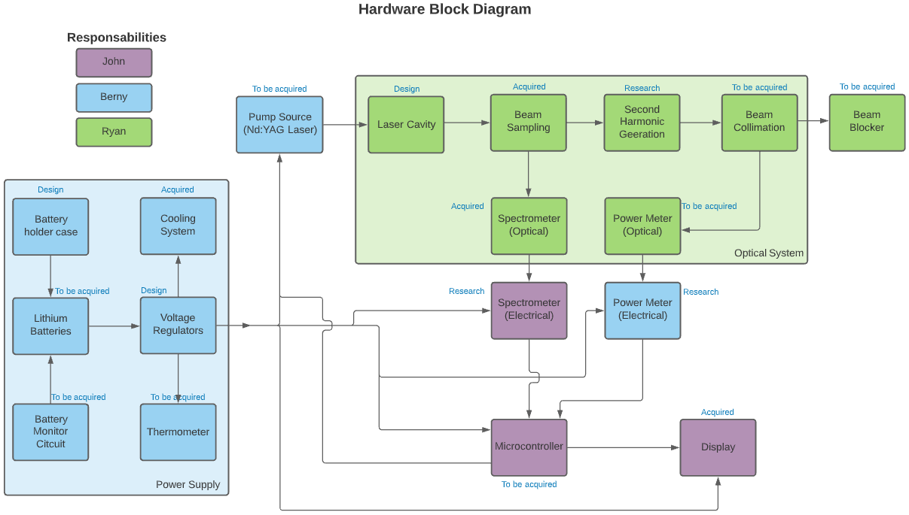

Slide 7
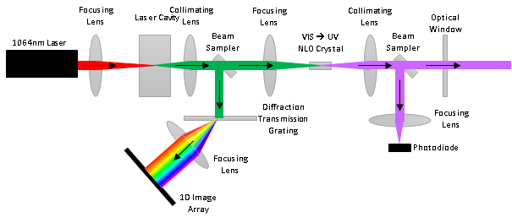
Overall Optical Design

Slide 8
Optical Component Sizes
Diameter
1” is common standard for free-space optics in labs
Easy to work with
Not so large as to be too expensive
3 mm for UV due to prices for UV-friendly substrates
This also means that the beam size is more restricted by the UV components than the VIS components

Slide 9
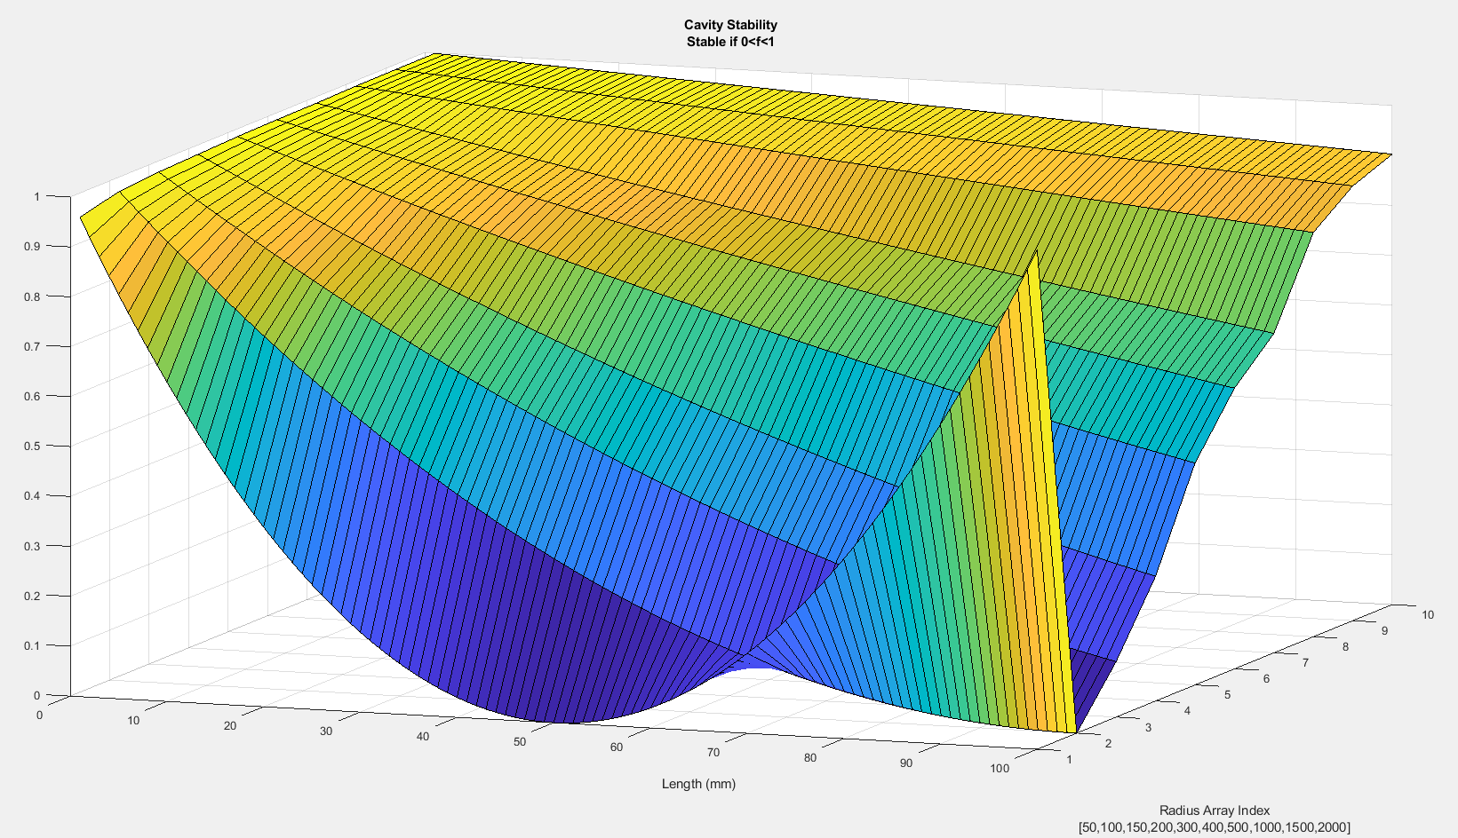
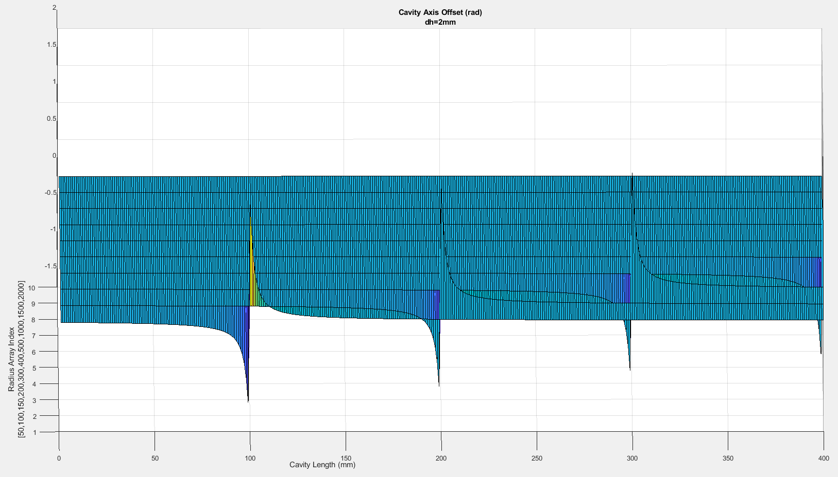
Mirror Radius Selection
Cavities unstable for OPLs at either ROC and at or past the sums of ROCs
Smaller ROCs more stable with rotational misalignments
Misalignment stability prioritized and 50 mm ROC selected
Higher reflectivity highly correlated to output power
 | Thorlabs Aluminum | Thorlabs Dielectric | Edmund Aluminum
Reflectivity at 532 nm (or closest) | 91.44% | 99.59% | ~91%
Price | $61.85 | $87.35 | $44.50

Slide 10
Cavity Design
Table Setup | 3D Printed
Easy to adjust Easier to observe segments | More precise More compact Liquid-tight Easier to use in final product
Flat Mirrors | Concave Mirrors
Cheaper | More stable compact cavities More volume for dye
“Linear” Cavity | Ring Cavity
More compact Geometrically simple | No overlapping beams ⇒ generalized parts
Dye Cavity | Dye Jet
Simpler design Smaller | Longer lasting More consistent output power Easier to pump

Slide 11
Cavity Design
Optical Window
Concave Mirror & KTP
Concave Mirror
Hot Mirror
1”
Optical Window

Slide 12
Cavity Details
OPL
Filled: ~60.45 mm
Empty: ~54.41 mm
Intracavity Beam Divergence: ~3°
Volume: <3.97 mL
Some room taken up by hot mirror
Some room must be left as air for sealing
Power: TBD

Slide 13
Laser Dye
Most common solvents are methanol and ethanol for laser dyes
Comparable prices
Comparable refractive indices (1.33 vs 1.36 respectively)
Additionally, smaller refractive index allows for smaller OPL which is more stable
Most commercially available dyes lase efficiently
Common dyes are Rhodamine 6 and Rhodamine B
Both cheap
Rhodamine B selected because a professor at CREOL has some
Dyes chosen that can be pumped at 532 nm
Cheaper Nd:YAG pumping
Pumping wavelength also reflected by cavity mirrors for multiple passes

Slide 14
Power Output Limitations
 | Diameter (in) | Area (cm^2) | Damage Threshold | Max Power (W)
Concave Mirror | 1 | 6.4516 | N/A | N/A
Beam Sampler (1%-10%) | .5 | 1.6129 | 7.5 J/cm^2 | 12.09675
Beam Sampler (1%-10%) | 1 | 6.4516 | 7.5 J/cm^2 | 48.387
Plano-Convex Lens | 1 | 6.4516 | N/A | N/A
Plano-Convex Lens (Coated) | 1 | 6.4516 | 7.5 J/cm^2 | 48.387
Cube Beam Splitter (Non-Polarizing) (50:50) | .5 | 1.6129 | 50 W/cm | 63.5
Most significant power limit is 12.09 W, which is much higher than we could hope for

Slide 15
Pump Source
Only 1064nm laser pointers were looked at due to lower prices compared to lab-quality emitters
Roithner selected after communication issues with Titan
 | Optical Power (mW) | Beam Diameter (mm) | Beam Divergence (mrad) | Mode | Temp (C) | Voltage (V) | Operating Mode | Lifetime (hours) | Price
Roithner | 100 | 1.5 | 1.5 | TEM₀₀ | 10 - 35 | 5 | CW | 5000 | $282.56
Titan | 150 | 3 | 2 | Multi | 15 - 35 | 4.2 | CW | 6000 | $249.95

Slide 16
Optical Sampling
Only a portion of the beam should be sampled off
Preferably a smaller portion of the beam so that the majority is left for output
Should work well in 400-700 nm or closest match
A comparable piece should be purchase-able for 200-350 nm or closest
 | Thorlabs |  |  | Edmund |  | Newport
Type | Plate | Cube | Sampler | Plate | Cube | Plate | Cube | Sampler
Splitting Ratio | 10:90 | 10:90 | <10:90 | 10:90 | 30:70 | 40:60 | 50:50 | <10:90
Size | ½” | 5mm | ½” | 12mm x 19mm | 10mm | 25.4mm | 6.35mm | 1”
Price | $99.82 | $166.38 | $41.32 | $32.50 | $214.00 | $150 | $198 | $107

Slide 17
Spectrometer
Measured in the VIS
SHG emission should be exactly half the peak in the VIS
VIS optics are cheaper and more common
Easier to calibrate due to VIS sources being more common
No slit needed
Fully blocked off from ambient light by being internal to the device
Casing should allow the spectrometer to be opened for construction and calibration
Diffraction Grating
Transmission: cheaper, more options
By the time parts were being looked at, price became a bigger issue, so we designed our system to work on a cheaper transmission grating. This can be upgraded later if necessary and affordable
Reflective: folds the system further, compacting it

Slide 18
Spectrometer Design
More lines/mm ⇒ more divergence ⇒ larger span for our desired range to measure ⇒ larger spectral resolution.
100 lines/mm
600 lines/mm
With the TCD2557D, having 5340 pixels over 37.38 mm, reading only 18.32 mm of it, we get a top resolution of .115 nm/pix and a lower resolution of 1.035 nm/pix at the edges.
1000 lines/mm

Slide 19
VIS to UV Conversion
This will be done by SHG in a NLO crystal
Two photons are absorbed of the VIS wavelength and one photon is emitted of the UV wavelength that is half the VIS wavelength
The crystal will need be to angle-tunable
Will need to be custom-cut if we want it to cover multiple VIS wavelengths well
Candidates:
BBO
CLBO

Slide 20
Optical Power Meter Design
Measured in the UV
Actual output power should be measured at the end of the device when no further conversions or splits occur
UV wavelengths can degrade quickly in air, so reading near the output facet of the device will estimate the closest to the output power of the device
UV Photodiode Sensor
Sampled collimated beam focused onto photodiode
If this shows to be too powerful or too difficult to focus, a diffuser could be used to average the power evenly over a larger area

Slide 21
Main Optical Train Design
Standard 1” lenses selected for VIS
Spherical lenses selected for lower average costs
Assumed 5.6° of intracavity half-angle divergence for making sure that beam diameters were always smaller than the maximum beam size possible for optical components
The largest angular divergence we were predicting so far was only around 3°
3mm lenses selected for UV due to larger prices
Focal lengths
Shorter focal lengths were preferred to make the device more compact while allowing for space for the optical components necessary between lenses (sampler and NLO crystal)
Extends <120 mm in front of the laser cavity

Slide 22
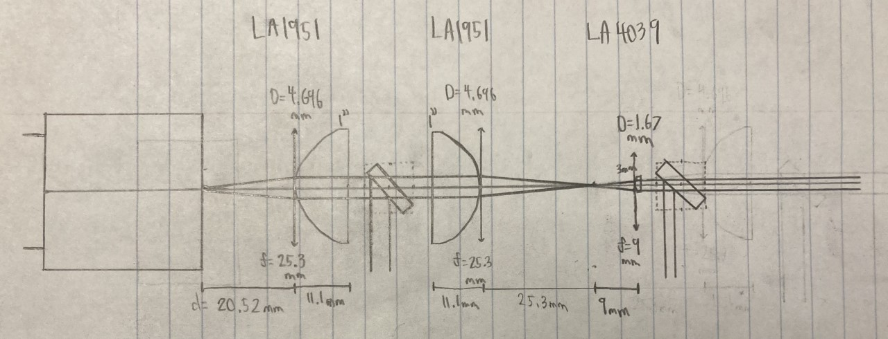
Main Optical Train Design
To-Scale Drawing
Simulation

Slide 23
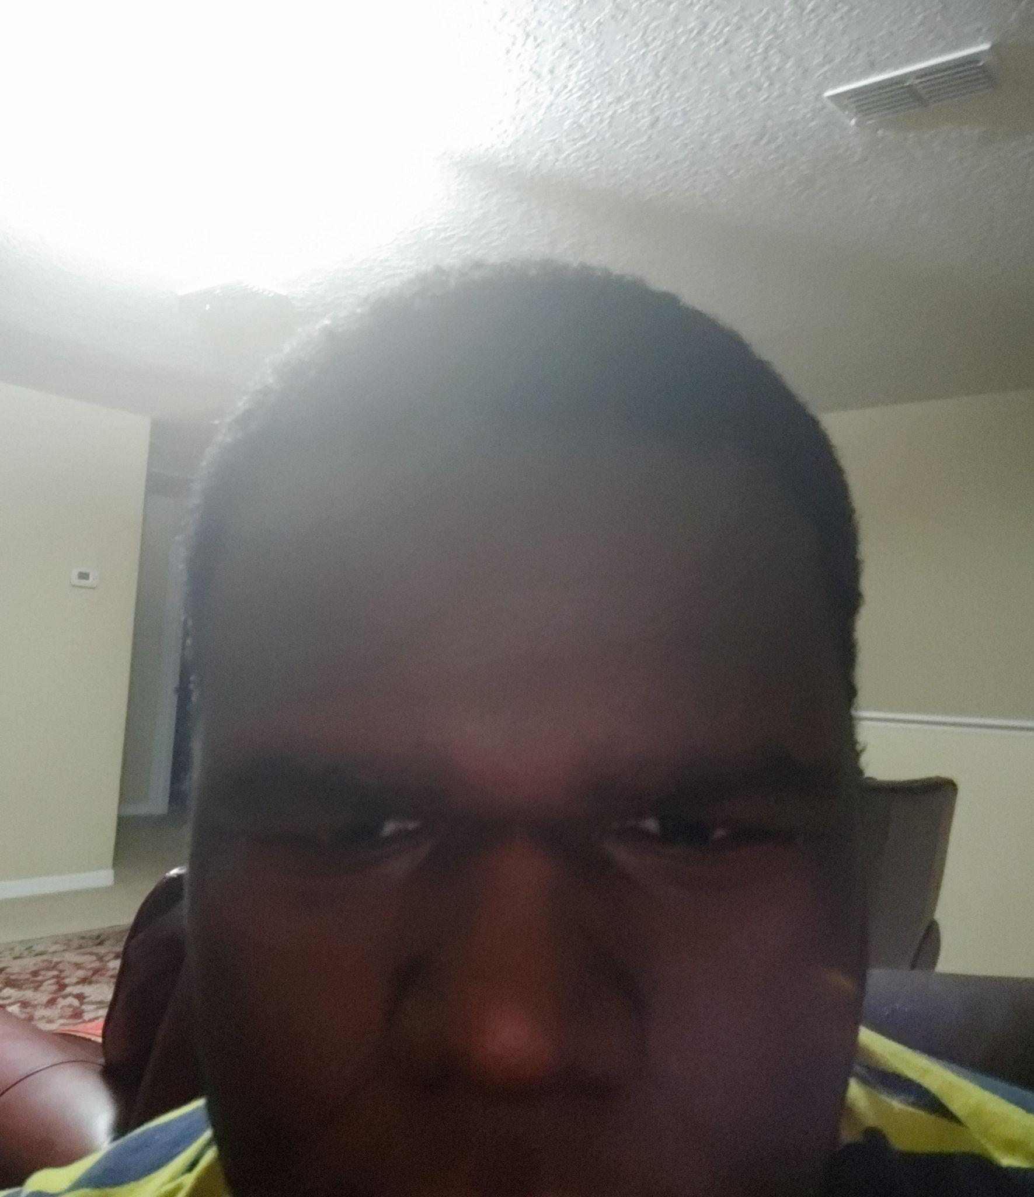
LMT70 Analog Thermometer
Brand: Texas Instruments
Supply Voltage: 5 V
Supply Current (Max/Typical): 12 µA/9.2 µA
Sensor Gain: -5.19 mV/ °C
Temperature accuracy (same tape and reel): Within 0.1°C.
Price: $0.62

Slide 24
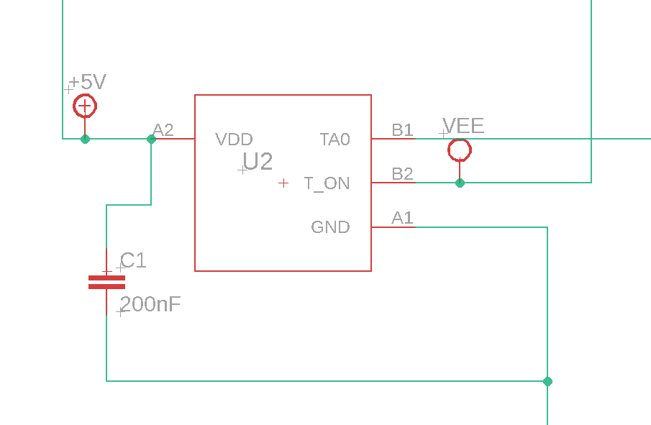
Design of LMT70 thermometer circuit
* VEE = 3.3 V, TA0 pin connects to P 8.8 on microcontroller

Slide 25
TMCS1108 Ammeter
Brand: Texas Instruments
Type: Galvanically Isolated Hall-Effect
Supply Voltage: 5 V
Sensor Gain: 400 mV/A
Current accuracy (Normal Conditions)(Max/Typical): ± 3%/1%
Operating temperature: -40°C to 125°C
Price: $0.84

Slide 26
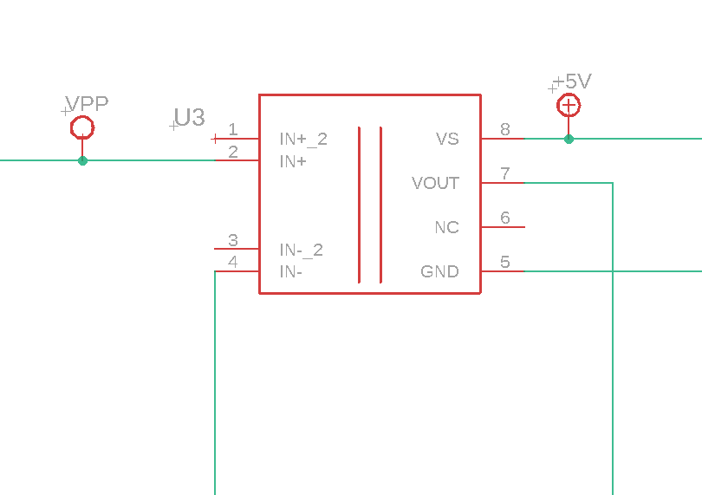
Design of TMCS1108 ammeter circuit
* Vpp is the batteries' voltage when connected, Vout will be connected to P8.7

Slide 27
Calculations of digital values
ADC resolution: 12 bits
Vref: 5V
Digital Output = 4093*Vinput/Vref
Offset = 4093*Voffset/Vref
Once digitized, the offsets must be subtracted/added to the result.
Reported digital value = Digital Output ± Offset digital Value

Slide 28
Transimpedance Amplifier
Designed to measure the power of ultraviolet waves (UV-A to UV-C). Silicon photodiodes allow us to measure these differences with their large responsivity range (200 nm to 1200 nm).
The responsivity curve is not completely flat. It is frequency-dependent so calculating requires the frequency. The image sensor will be critical for to creating values for the user.

Slide 29
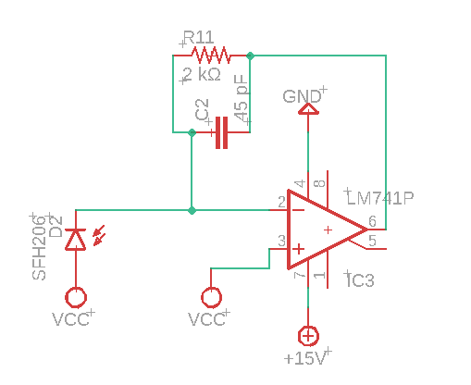
Transimpedance Amplifier
* Vcc = 7.5 V

Slide 30
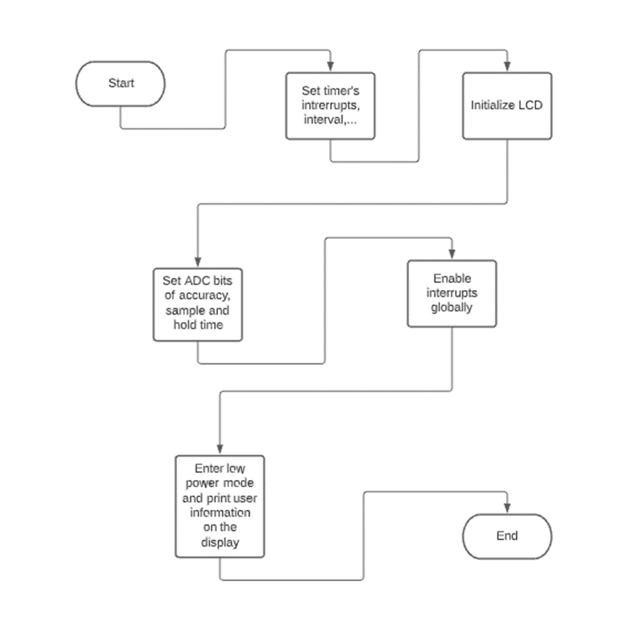
Software flowchart (Main Function)

Slide 31
Interrupts
Button Interrupt: It must change the values displayed on the LCD. The timer interrupt must now refresh new values and a variable will set this. The button interrupt must also reset a variable to prepare for the next time the user changes (presses the button) the displayed values.
Timer Interrupt: It must refresh the values on the display. It will fetch values from the ADC registers and perform operations to obtain a value. Neither interrupt needs to be preemptable.

Slide 32
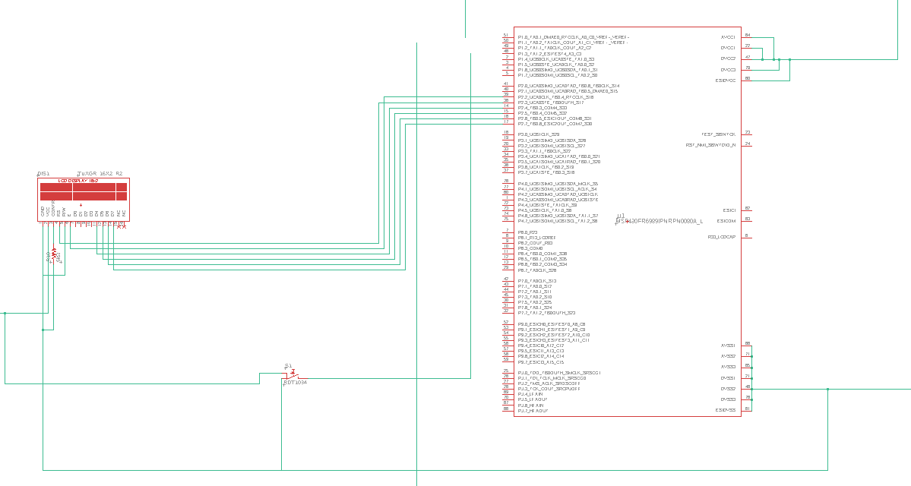
Microcontroller and LCD

Slide 33
Power delivery
The power supply will deliver power to:
The battery monitoring system
Cooling system
Pump source
Spectrometer
Power meter
Microcontroller
Ammeter
Thermometer
The display.

Slide 34
Power Supply Design
Battery powered
Rechargeable batteries
Li-ion rechargeable batteries
Voltage Regulators
Battery monitoring system

Slide 35
Lithium-Ion vs NiMH
Battery monitoring system influence our decision
Advantages for the two technologies
Li-ion | NiMH
Nominal voltage | Cost
Weight | Capacity
Charge time | Safety
Self-discharge rate

Slide 36
Battery Monitoring System
To provide short-circuit, overcharge and over discharge protection.
Design or Bought consideration
Comparison between designed and bought options
Bought | Designed
Economical | More expensive
Lots of protection features | Selective features
Draws a low current | Draws high current
No assembly required | Research and time required

Slide 37
Voltage Regulators
We will make use of voltage regulator to step up or step down the voltage from 3.7 to the all required component voltages
We will be using 4 different voltage regulator (power supply circuits) to supply voltages of 3.3, 5, 7.5 and 15V
In order to accomplish this task we design and will obtain them through the Texas Instruments website.

Slide 38
Power Supply Circuits
The 15V power supply will power the transimpedance circuit and is capable of outputting 100 mA.
The 7.5V power supply will be used to zero bias the photodiode and is capable of outputting 10 mA.
The 5V power supply will be used to power the temperature sensor, ammeter, and operates as reference voltage for the ADC and is capable of outputting 500 mA.
The 3.3V power supply will be used to power the microcontroller and is capable of outputting 20 mA.

Slide 39
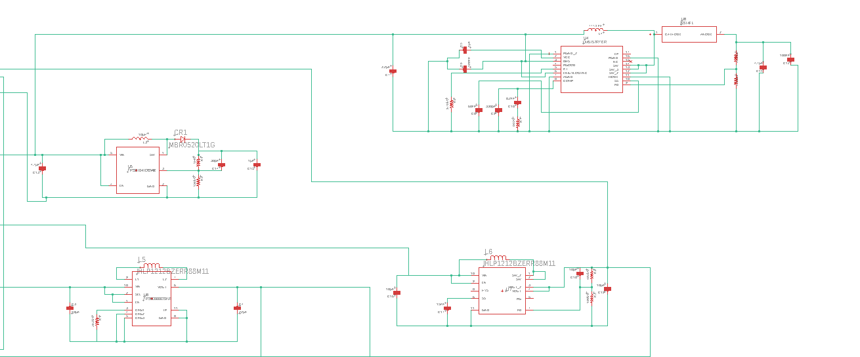
Power Supply Circuits
* Top Left- 7.5 V, Top Right - 15 V, Bottom Left - 3.3 V, Bottom Right - 5 V

Slide 40
Cooling System
Two fans that blow air into/out of the housing.
The fans will be placed to add cold air to the bottom (near batteries) and remove warm air from the top. Exploiting their density differences.
Batteries will be separated by more than 2 cm to increase air flow.
We will use 2-wire brushless DC fans with a speed that is dependent on the supply voltage. The fan speed will be constant.
The thermometer's purpose is for diagnostic purposes or emergency powering off. It will not be used to adjust fan settings.

Slide 41
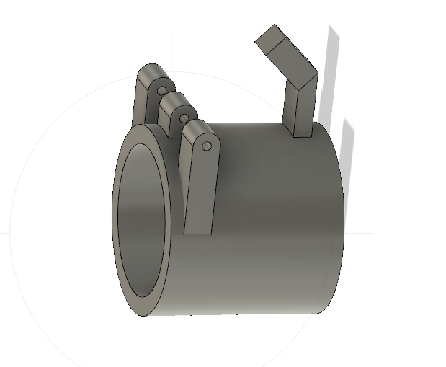
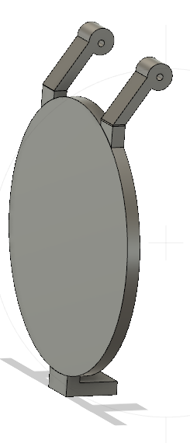
Beam Blocker

Slide 42
Costs
Item | Summed Cost
Laser Cavity | $294.38
Main Optical Train | $155.14
Spectrometer | $79.50
Optical Power Meter | $120.25
Optical Pump Source | $308.14
Power supply | $57.11
Display and Push button | $14.70
Sensor system | $2.31
Microcontroller | $25.00
Total | $1,056.53

Slide 43
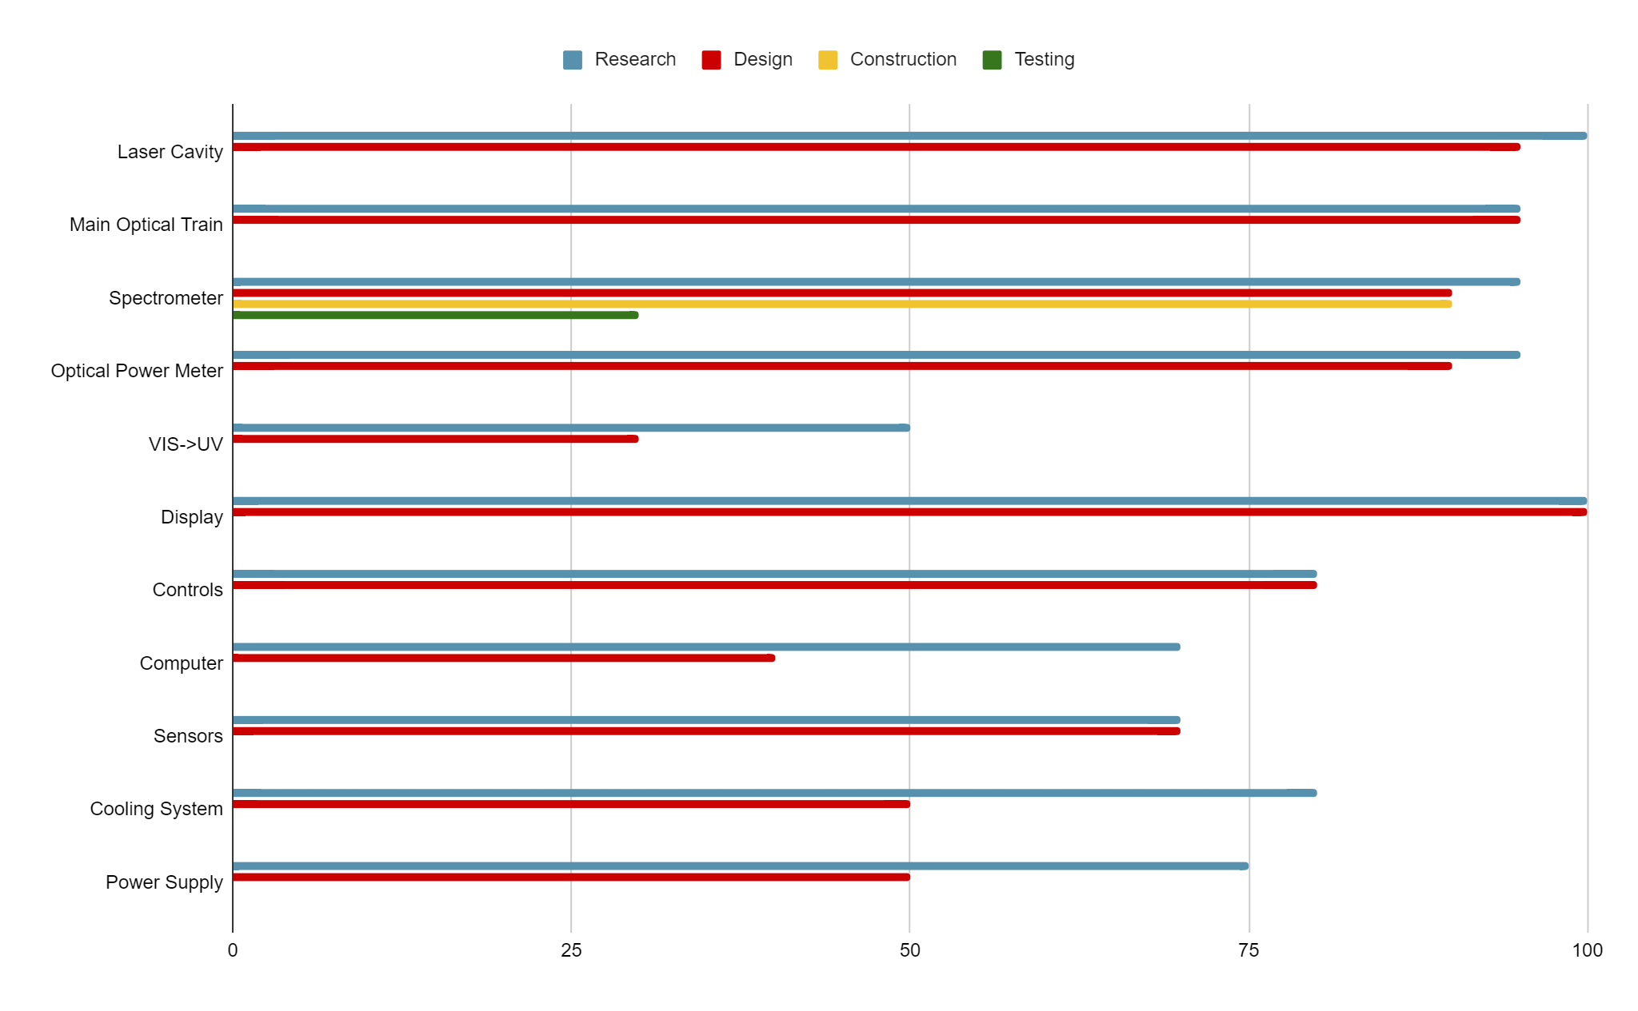
Progress

Slide 44
Next Steps
Laser Cavity
Finish touch-ups on 3D model and print it
Order in remaining parts and construct cavity
Begin testing with low-powered pump source in lab
Main Optical Train
Order in remaining components
Begin designing the base housing for the optical train
VIS ⇒ UV
Meet with Dr. Hagan to further discuss process and get further direction
Alternatively, just get more quotes from NLO crystal manufacturers on prices
Power Supply
Finalized calculating power requirements after pump source testing
Order PMS after power requirements are calculated
Order batteries
Obtain battery holder case
Software
Begin writing the code required to accomplished all desired functions
Cooling System
Find the voltage that provides the optimal fan speed (low power, low temperature)

